Slide 1
Angular basics
Routing

Slide 2
Browser routing
The browser is a familiar model of application navigation:
Enter a URL in the address bar and the browser navigates to a corresponding page.
Click links on the page and the browser navigates to a new page.
Click the browser's back and forward buttons and the browser navigates backward and forward through the history of pages you've seen.

Slide 3
Angular router
The Angular Router borrows from this model.
It can interpret a browser URL as an instruction to navigate to a client-generated view.
You can bind the router to links on a page and it will navigate to the appropriate application view when the user clicks a link.
And the router logs activity in the browser's history journal so the back and forward buttons work as well.

Slide 4


Location strategy
PathLocationStrategy
HashLocationStrategy

Slide 5
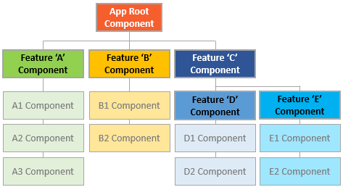
Routes tree

Slide 6
Route guards
CanActivate (e.g. check for authentication)
CanActivateChild
CanDeactivate (e.g. handle unsaved changes)
Resolve
CanLoad

Slide 7
DEMO

Slide 8
Q&A

